Slide 1
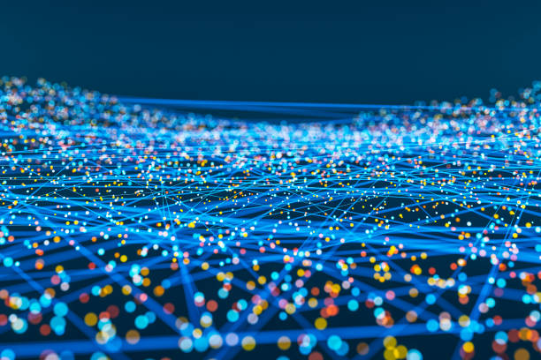
LEARNING AFFECTIVE VIDEO FEATURES FOR FACIAL EXPRESSION RECOGNITION VIA HYBRID DEEP LEARNING

Slide 2
INTRODUCTION
CLASSIFICATION
FER
methods
Image based methods
(static)
Video based methods
(dynamic)

Slide 3
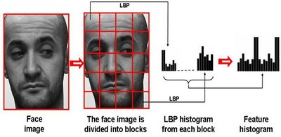
RELATED WORK
HAND DESIGNED FEATURE BASED METHODS
For facial feature representation in static images a variety of local image descriptors have been used:-
LOCAL BINARY PATTERNS (LBP)

Slide 4
HISTOGRAM OF ORIENTED GRADIENTS (HOG)
Cells
Angular Bins
Blocks
Descriptor

Slide 5
SCALE INVARIANT FEATURE TRANSFORM (SIFT)
Sift key points of objects are first extracted from a set of reference images and stored in a database.
An object is recognised in a new image by individually comparing each feature from the new image into its database.
Find the candidate matching feature based on Euclidian distance of their feature vectors.
From the full set of matches , subsets of key points that agree on the object and its location ,scale and orientation in the new image are identified to filter out good matches.

Slide 6
The determination of consistent clusters is performed rapidly by using an efficient hash table implementation.
Each cluster of three or more features that agree on an object and its pose, is then subject to further detailed model verification and subsequent outliers are discarded.
Finally, the probability that a particular set of features indicates the presence of an object is compared, given the accuracy to fit and number of probable false matches.
Object matches that pass all these tests can be identified as correct with high confidence.

Slide 7
For dynamic expression recognition these typical local features have been extended and applied to video sequences such as :
LBP-TOP
3D-HOG
3D-SIFT

Slide 8
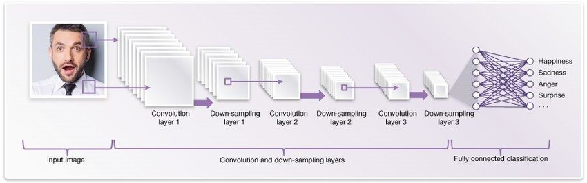
b. Deep learning based method
CNN
3D-CNN

Slide 9
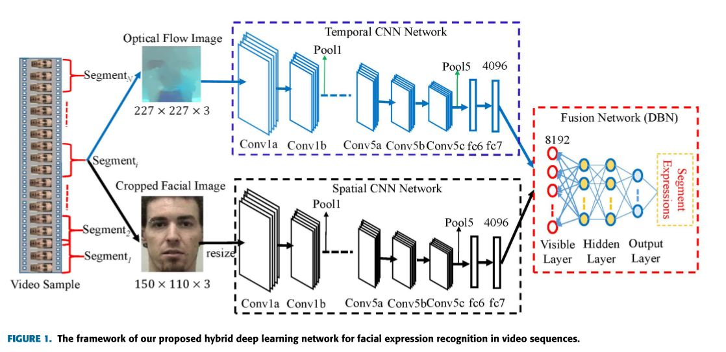
METHODOLOGY
Generation of CNN inputs
Spatio-temporal feature learning with CNN
Spatio-temporal fusion with DBNs
Video-based expression classification
Framework of the proposed model

Slide 10

1.Generation of cnn inputs
Dividing the video sample
Inputs of Spatial CNN
Inputs of Temporal CNN
a)
b)
c)

Slide 11
a) Dividing THE video sample
Each video sample is divided into fixed length segments with L=16.
If L>16:
Eliminate first and last (L-16)/2 frames.
If L<16:
Duplicate first and last (16-L)/2 frames.

Slide 12
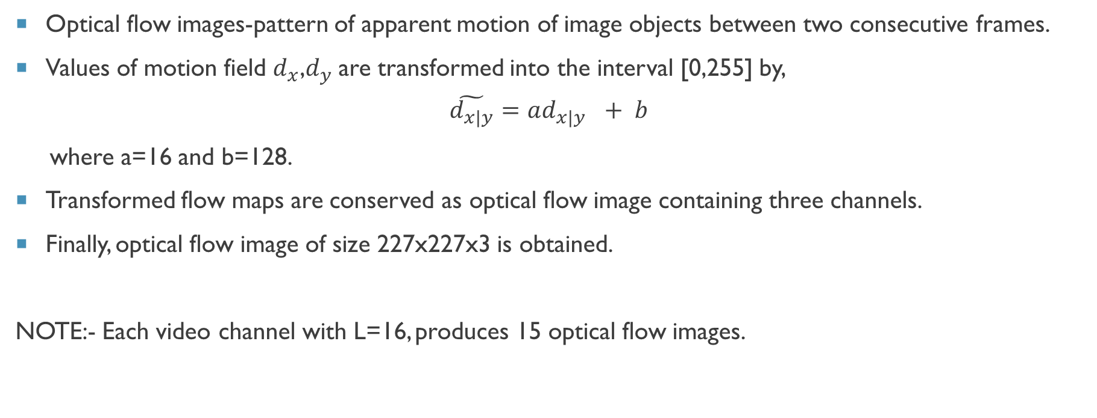
B) Inputs OF temporal cnn
Optical flow images-pattern of apparent motion of image objects between two consecutive frames.
Values of motion field $d_{x}$,$d_{y}$are transformed into the interval [0,255] by,
$$\tilde{d_{x|y}}=ad_{x|y }+ b$$
where a=16 and b=128.
Transformed flow maps are conserved as optical flow image containing three channels.
Finally, optical flow image of size 227x227x3 is obtained.
NOTE:- Each video channel with L=16, produces 15 optical flow images.

Slide 13
c) Inputs of spatial cnn
Robust real time face detector is used to detect the face.
Normalised distance between eyes - Cropped image of size 150 x110x3 is obtained.
Resize cropped image to 227x227x3 as inputs to spatial CNN.
NOTE:- Discard the first frame in a video segment L=16, and employ the remaining 15 frames as input.

Slide 14
Framework of the proposed model

Slide 15
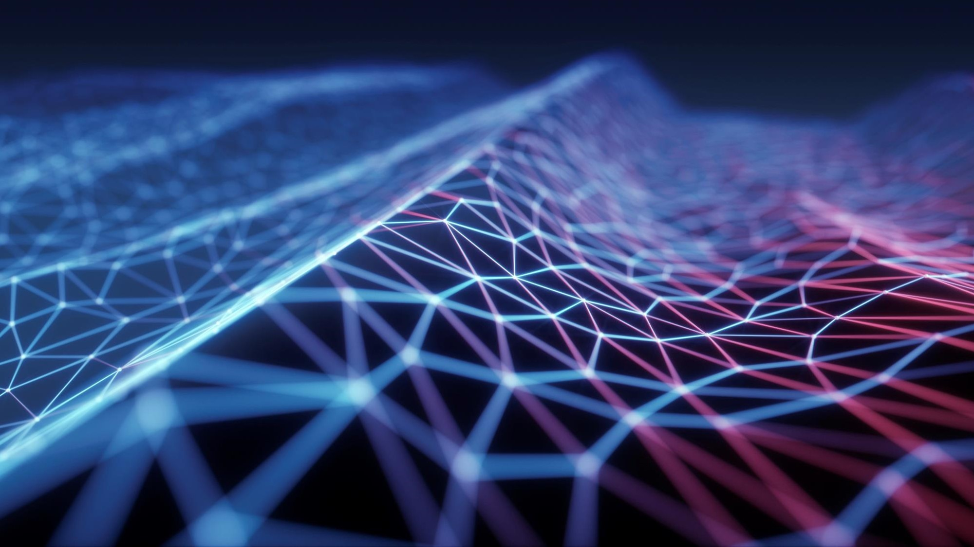

2. SPATIO-TEMPORAL FEATURE LEARNING WITH CNNS
VGG16 Architecture

Slide 16
Spatio-temporal Feature learning with Cnns
1.
Copy existing VGG16 parameters.
2.
Replace FC8 layer with new class label vector – 6 facial expressions.
3.
Individually retrain two CNN streams.

Slide 17
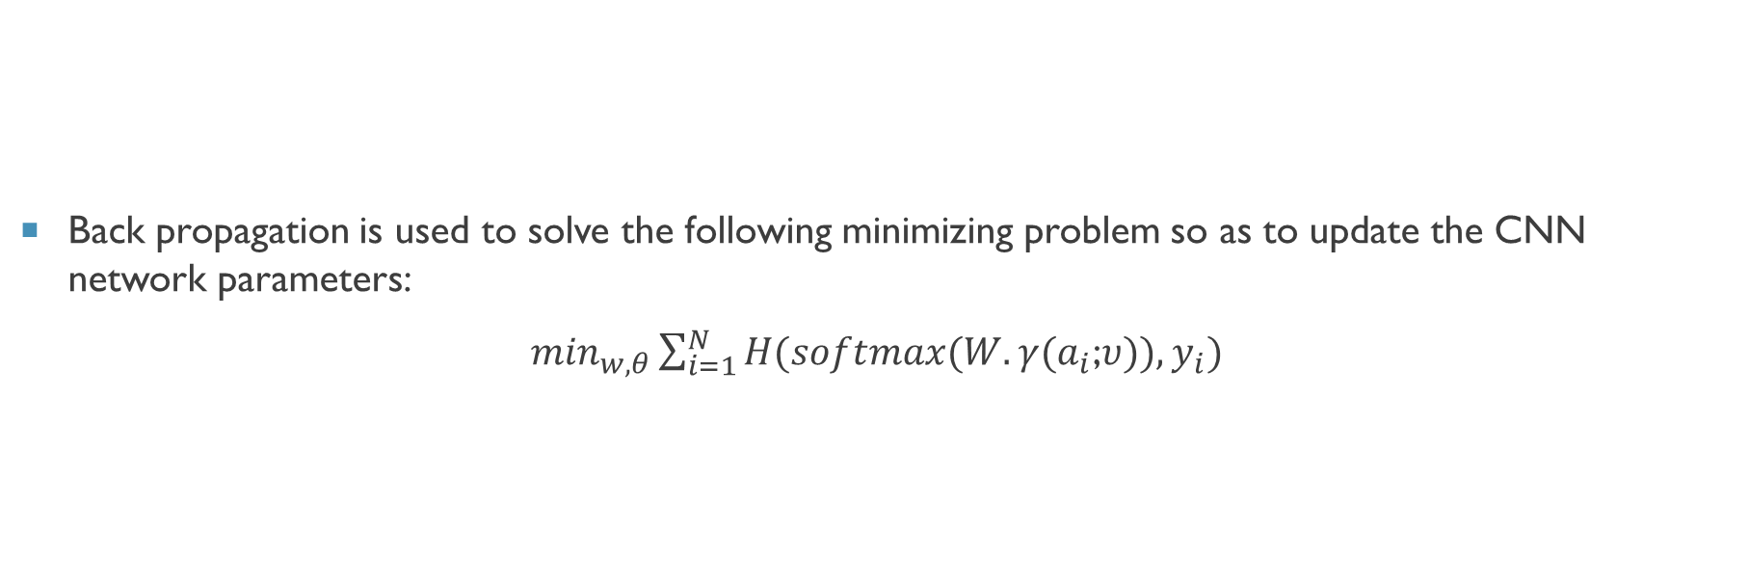
SPATIO-TEMPORAL FEATURE LEARNING WITH CNNS
Back propagation is used to solve the following minimizing problem so as to update the CNN network parameters:
$\min_{w,θ}\sum_{i=1}^{N}{H(softmax(W.γ(a_{i}}$;$υ)),y_{i})$

Slide 18


3. SPATIO-TEMPORAL FUSION WITH DBNS
WHAT ARE DEEP BELIEF NETWORKS ?

Slide 19

RESTRICTED BOLTZMANN MACHINES
STRUCTURE OF RBM
BRAIN CHILD OF
GEOFF HINTON @ UNIV OF TORONTO
Visible Layer
Hidden Layer

Slide 20
RECREATE INPUT
Visible Layer
Visible Layer
Hidden Layer
Hidden Layer
FORWARD
BACKWARD

Slide 21
DEEP BELIEF NETWORK
STRUCTURE OF DBN
1. PRE-TRAINING
2. FINE TUNING
Labels
BRAIN CHILD OF
GEOFF HINTON @ UNIV OF TORONTO
Input layer
Output layer
Hidden layers

Slide 22

During unsupervised learning the weights of each RBM is updated as follows,
∆w=ϵ(<v_{i}h_{j}>_{data} - <v_{i}h_{j} >_{model})
Supervised fine tuning is realized by the following loss function between the input data and the reconstructed data,
L (x, x’) = ||x-x’${||}_{2}^{2}$

Slide 23

4. VIDEO-BASED EXPRESSION CLASSIFICATION
Output of the last hidden layer represent the jointly learned spatio-temporal feature representation.
Apply average pooling on all divided segments-fixed length global video feature representation.
Adopt linear SVM classifier.

Slide 24
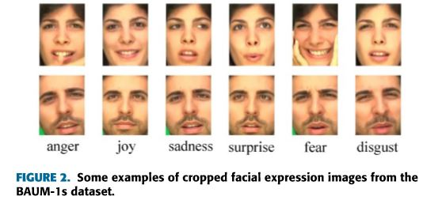
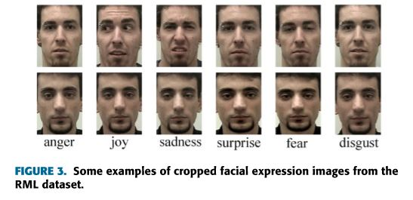
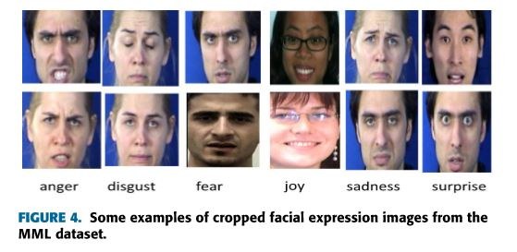
DATASETS
BAUM-1s Dataset
RML dataset
MMI Dataset

Slide 25

RESULTS AND ANALYSIS
PERFORMANCE OF DIFFERENT DBN STRUCTURES
ADVANTAGE OF FUSING SPATIO-TEMPORAL FEATURES WITH DBN
RECOGNITION PERFORMANCE OF EACH FACIAL EXPRESSION

Slide 26
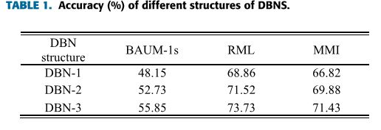
RESULTS AND ANALYSIS
Verify performance of different DBNs
The performance of three DBN structures have been compared.
DBN-1(8192-4096-6)
DBN-2(8192-4096-2048-6)
DBN-3(8192-4096-2048-1024-6)
Accuracy (%) of different structures of DBN

Slide 27
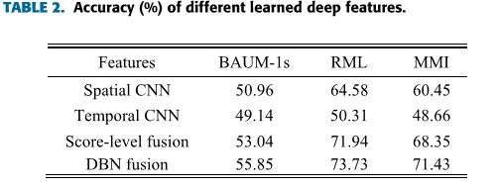
RESULTS AND ANALYSIS
Verify advantage of fusing spatio-temporal features with DBN
The performance of four methods have been taken into consideration.
Single spatial CNN features
Single temporal CNN features
Score-level fusion based on spatio-temporal CNN features
DBN fusion based on spatio-temporal CNN features
Accuracy (%) of different learned deep features

Slide 28
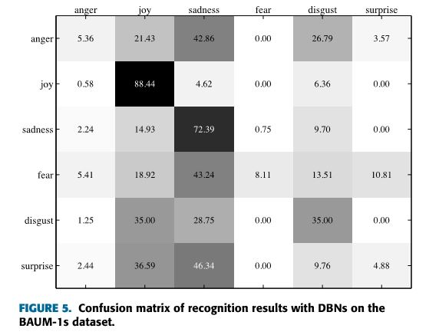
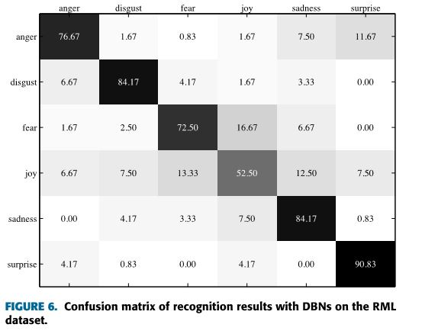
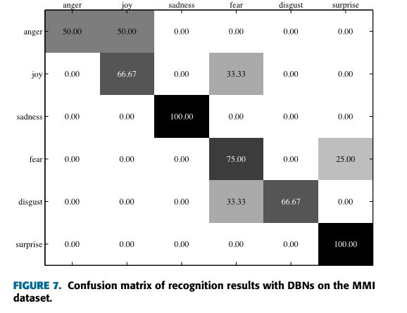
RESULTS AND ANALYSIS
Verify recognition performance of each facial expression
Confusion matrix of recognition results with DBNs on the BAUM-1s dataset
Confusion matrix of recognition results with DBNs on the RML dataset
Confusion matrix of recognition results with DBNs on the MMI dataset

Slide 29
DATASETS | FEATURES | ACCURACY
BAUM-1S | LPQ 3D-CNN DAP Spatio-temporal CNN+DBN | 45.04 30.11 55.85
RML | Gabor 3D-CNN Spatio-temporal CNN+DBN | 64.58 68.09 73.73
MMI | 3DCNN-DAP Inception-ResNet Spatio-temporal CNN+DBN | 63.40 68.51 71.43
Performance (%) comparison of the state-of-the arts on the used three datasets

Slide 30

CONCLUSION

Slide 31
REFERENCES
[1] B. Martinez, M.F. Valstar, B.Jiang andM.Pantic,‘‘Automaticanalysisoffacial actions: A survey,’’ IEEE Trans. Affective Comput., to be published. doi: 10.1109/TAFFC.2017.2731763.
[2]X.ZhaoandS.Zhang,‘‘Areviewonfacialexpressionrecognition:Feature extractionandclassiﬁcation,’’IETETech.Rev.,vol.33,no.5,pp.505–517, 2016
[3] P.ViolaandM.J.Jones,‘‘Robustreal-timefacedetection,’’Int.J.Comput. Vis., vol. 57, no. 2, pp. 137–154, 2004.
[4] G. E. Hinton, S. Osindero, and Y.-W. Teh, ‘‘A fast learning algorithm for deep belief nets,’’ Neural Comput., vol. 18, no. 7, pp. 1527–1554, 2006.
[5] K. Zhang, Y. Huang, Y. Du, and L. Wang, ‘‘Facial expression recognition basedondeepevolutionalspatial-temporalnetworks,’’IEEETrans.Image Process., vol. 26, no. 9, pp. 4193–4203, Sep. 2017.
[6] K. Simonyan and A. Zisserman, ‘‘Very deep convolutional networks for large-scaleimagerecognition,’’inProc.ICLR,SanDiego,CA,USA,2015, pp. 1–14
[7] K. Simonyan and A. Zisserman, ‘‘Two-stream convolutional networks for actionrecognitioninvideos,’’inProc.Int.Conf.NeuralInf.Process.Syst., Montreal, QC, Canada, 2014, pp. 568–576
[8] A. Krizhevsky, I. Sutskever, and G. E. Hinton, ‘‘ImageNet classiﬁcation with deep convolutional neural networks,’’ in Proc. Adv. Neural Inf. Process. Syst., 2012, pp. 1106–1114.

Slide 32
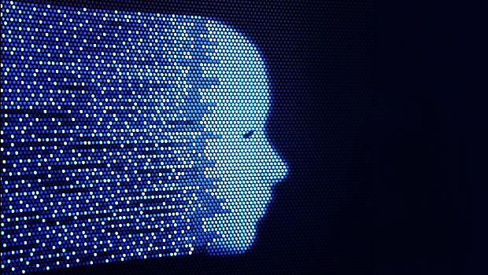
Thank You

